Slide 1
Getting into Frontend Development
...not an introduction

Slide 2
Pre-requisites
Vanilla JS
ECMAScript 2015+
Node and NPM
Basic Understanding of REST API

Slide 3
Libraries and Frameworks
AngularJS
Angular 2+
React
Vue
Preact
Ember

Slide 4

React
React
Mutation
Components
State and Props
Stateful and Stateless Components
Hooks
Higher Order Components
Virtual DOM

Slide 5
Installation
Official Build Tools (Recommended)
$ npm install -g create-react-app
$ create-react-app my-app
Starter Packs
https://github.com/kriasoft/react-starter-kit
https://github.com/react-boilerplate/react-boilerplate
https://github.com/coryhouse/react-slingshot
Build your own
https://www.javascriptstuff.com/build-your-own-starter/#0-intro

Slide 6
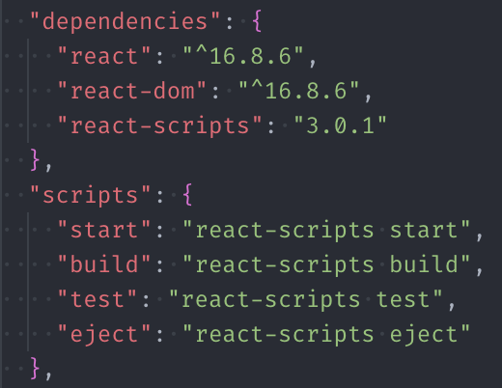
Getting Started
Package.json and NPM scripts
$ npm run start
# Starts a webpack dev server
$ npm run build
# Generates a production ready build
$ npm run test
# Runs tests using Jest
$ npm run eject
# Extracts all configs and settings used by react-scripts and create-react-app for manual configuration

Slide 7
Components
Introduction
Lifecycle
componentWillMount
Before the first render
componentDidMount
After the first render
componentWillUnmount
Before unmounting
Render
componentDidUpdate
componentWillReceiveProps

Slide 8
Minimal Component Syntax
// myComponent.js
import React from 'react';
class MyComponent extends React.Component {
render() {
return <div>Hello World</div>;
}
}
export default MyComponent;
import React from 'react';
import MyComponent from './myComponent';
class App extends React.Component {
render() {
return <div>
<MyComponent />
</div>;
}
}
export default App;
Import React
Create a class for the component that extends React.Component
Create a render function that returns JSX
Export the component

Slide 9
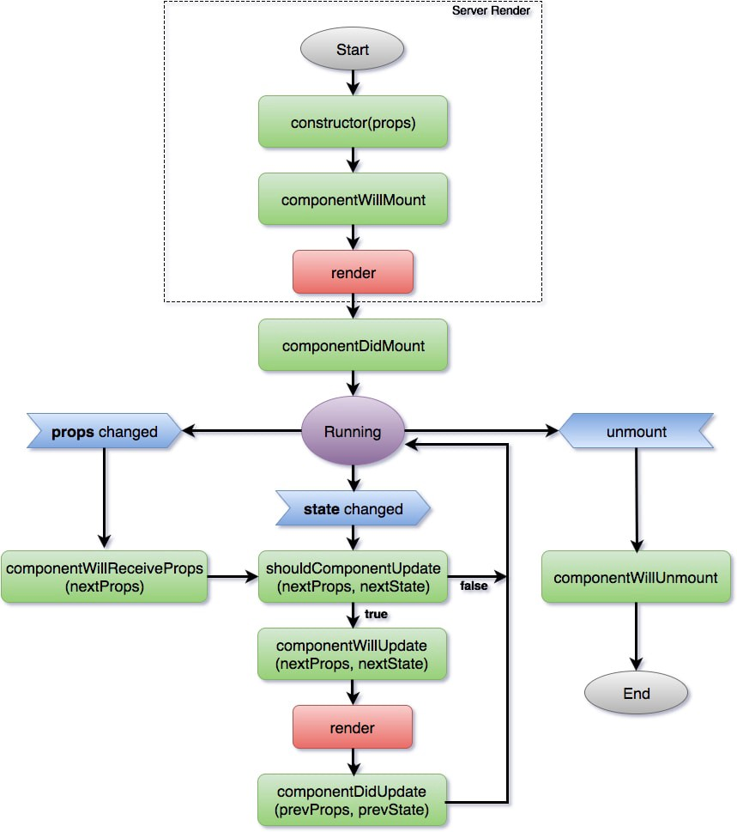
Component Lifecycle
import React from 'react';
class MyComponent extends React.Component {
constructor() {
super();
}
componentWillMount() {
console.log('Will Mount');
}
componentDidMount() {
console.log('Did Mount');
}
componentDidUpdate(prevProps, prevState) {}
shouldComponentUpdate(nextProps, nextState) {}
componentWillUnmount() {
console.log('Will Unmount');
}
render() {
console.log('Render');
return <div>Hello World</div>;
}
}
export default MyComponent;

Slide 10
State and Props
Introduction
State
Values defined in the component
this.state, this.setState
Props
Values passed down by parents

Slide 11
Component State
import React from 'react';
class MyComponent extends React.Component {
constructor() {
super();
this.state = {
counter: 0,
};
this.updateCounter = this.updateCounter.bind(this);
}
updateCounter() {
this.setState({
counter: this.state.counter + 1,
});
}
render() {
return <div>
<p>Counter {this.state.counter}</p>
<button onClick={this.updateCounter}>Increase</button>
</div>;
}
}
export default MyComponent;

Slide 12
Component Props
<MyComponent
age={30}
name="John Doe"
onSubmit={() => console.log('clicked')}
/>
import React from 'react';
class MyComponent extends React.Component {
render() {
return <div>
<p>Name: {this.props.name}</p>
<button onClick={this.props.onSubmit}>Click me</button>
</div>;
}
}
export default MyComponent;

Slide 13
Stateful and Stateless Components
Introduction
Stateful vs Stateless
Why Stateless?
Smaller footprint (No need to extend React.Component)
Easier to use
For components that are completely dumb

Slide 14
Stateful and Stateless Component
// Stateful
import React from 'react';
class MyComponent extends React.Component {
constructor() {
super();
this.state = {};
}
render() {
return <div>{this.props.name}</div>;
}
}
export default MyComponent;
// Stateless
import React from 'react';
function MyComponent(props) {
return <div>{props.name}</div>;
}
// OR
const MyComponent = props =>
<div>{props.name}</div>;
export default MyComponent;

Slide 15
React Hooks
Introduction
useState
useEffect
useRef
useCallback
useMemo

Slide 16
React Hooks - useState
import React, { useState } from 'react';
function MyComponent() {
const [counter, setCounter] = useState(0);
return (
<div>
<p>{counter}</p>
<button onClick={() => setCounter(counter + 1)}>Update</button>
<button onClick={() => setCounter(0)}>Reset</button>
</div>
);
}
export default MyComponent;

Slide 17
React Hooks - useEffect
import React, { useState, useEffect } from 'react';
function MyComponent() {
const [counter, setCounter] = useState(0);
useEffect(() => {
console.log('Called Once');
return () => console.log('Unmount'); // componentWillUnmount
}, []); // componentDidMount
useEffect(() => {
console.log('Updated', counter);
}, [counter]); // componentDidUpdate
return (
<div>
<p>{counter}</p>
<button onClick={() => setCounter(counter + 1)}>Update</button>
<button onClick={() => setCounter(0)}>Reset</button>
</div>
);
}
export default MyComponent;

Slide 18
HOC
Introduction
Common Usage
Prop injection
Wrapper Component
Composition
Containers and Presenters

Slide 19
HOC
import React from 'react';
import MyApp from './myApp';
import Loading from './loading';
const withLoading = Component => {
class Loader extends React.Component {
constructor() {
super();
this.state = { loaded: false, data = [] };
}
componentDidMount() {
loadData().then(data => {
this.setState({ loaded: true, data });
});
}
render() {
<div>
{this.state.loaded ?
<Component data={this.state.data} /> :
<Loading />
}
</div>
}
}
return Loader;
}
const EnhancedApp = withLoading(MyApp);
<EnhancedApp />;
// Composition (Eg. from recompose)
const BaseComponent = props => {...}
// This will work, but it's tedious
let EnhancedComponent = pure(BaseComponent);
EnhancedComponent = mapProps(/*...args*/)(EnhancedComponent);
EnhancedComponent = withState(/*...args*/)(EnhancedComponent);
// Do this instead
// Note that the order has reversed — props flow from top to bottom
const enhance = compose(
withState(/*...args*/),
mapProps(/*...args*/),
pure
);
const EnhancedComponent = enhance(BaseComponent);

Slide 20
Virtual DOM
Introduction
Tree shape representation of the DOM
Diffing and updating only the changes
Reconciliation Algorithm

Slide 21

Redux
State Management
Redux
Actions, Reducers, Store
Connect
Map State To Props, Map Dispatch To Props

Slide 22
Installation and Usage
Add to a NPM project
$ npm install redux
Import redux and use
import { createStore } from 'redux';

Slide 23
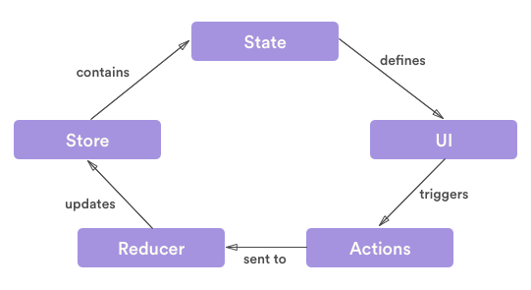
Three Principles of Redux
The state of the whole application is stored in a single object within a single store.
State is read-only. It can only be modified by emitting an action, which is an object that describes an event
Changes are made using pure functions, called reducers.

Slide 24
Actions and Action Creators
Actions
Flux Standard Action
Action Creator

Slide 25
Action
An action is a Javascript object with a minimum single key value pair of key name 'type'.
{
type: 'INCREASE_COUNTER'
}
{
type: 'SET_VALUE',
payload: 50
}
An action creator is a function that returns an action.
const setName = name => ({
type: 'SET_NAME',
payload: {
name
}
});

Slide 26
Reducers and Store
Reducer
combineReducers
Store
getState
Dispatch
subscribe

Slide 27
Reducer
A function that takes a state and an action and returns a new state
const reducer = (state = 0, action) => {
switch(action.type) {
case 'INCREMENT':
return state + 1;
case 'DECREMENT':
return state - 1;
default:
return state;
}
}
import { combineReducers } from 'redux';
const rootReducer = combineReducers({
form: formReducer,
data: dataReducer,
loading: loadingReducer,
});

Slide 28
Store
createStore(reducers, state, enhancers)
getState: Get current state of store
dispatch: Emit an action and trigger reducers
subscribe: Get notified that the store has changed
import { createStore } from 'redux';
const INITIAL_STATE = {
todoList: [],
};
const store = createStore(reducer, INITIAL_STATE);
const action = {
type: 'CLEAR_TODO_LIST',
};
store.getState(); // { todoList: [] }
store.dispatch(action);
store.subscribe(() => {
store.getState();
});

Slide 29
connect
Integrating with React
react-redux
connect
mapStateToProps
mapDispatchToProps

Slide 30
Working with React
import { connect } from 'react-redux';
const mapStateToProps = state => ({
list: state.filters.list,
selected: state.filters.selected,
});
const mapDispatchToProps = dispatch => ({
setSelected: selected => dispatch({
type: 'SET_SELECTED_FILTER',
payload: { selected }
}),
clearList: () => dispatch(clearFilters()),
});
const EnhancedComponent = connect(
mapStateToProps,
mapDispatchToProps,
)(MyApp);

Slide 31
Further
Learning
Routing (react-router-dom)
Babel, Webpack
Fetch and Axios
Project Structure
React Context API
Redux-thunk
Redux Toolkit
React Native

Slide 32
Finally...
The one speaking will present some final words.

